Slide 1
Mole Concept

Slide 2
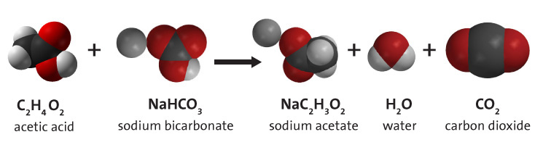
Significance of Mole Concept
Mole calculation is the fundamental basis behind any chemical reaction.

Slide 3
Mole
Definition: The amount of any substance that contains as many elementary entities (e.g. atoms, molecules, ions) as there are atoms in 12 grams of pure carbon-12 (¹²C), the isotope of carbon with relative atomic mass of 12.
We can think about it like:
A group count like dozen
How we count atoms, molecules and ions
It is abbreviated as mol
1 mole = 24 digit significant number (Avogadro`s number, denoted as N_{A})
To 8 significant numbers, it is 6.0221367 x 10²³
For most practical purposes, it is 6.022 x 10²³

Slide 4
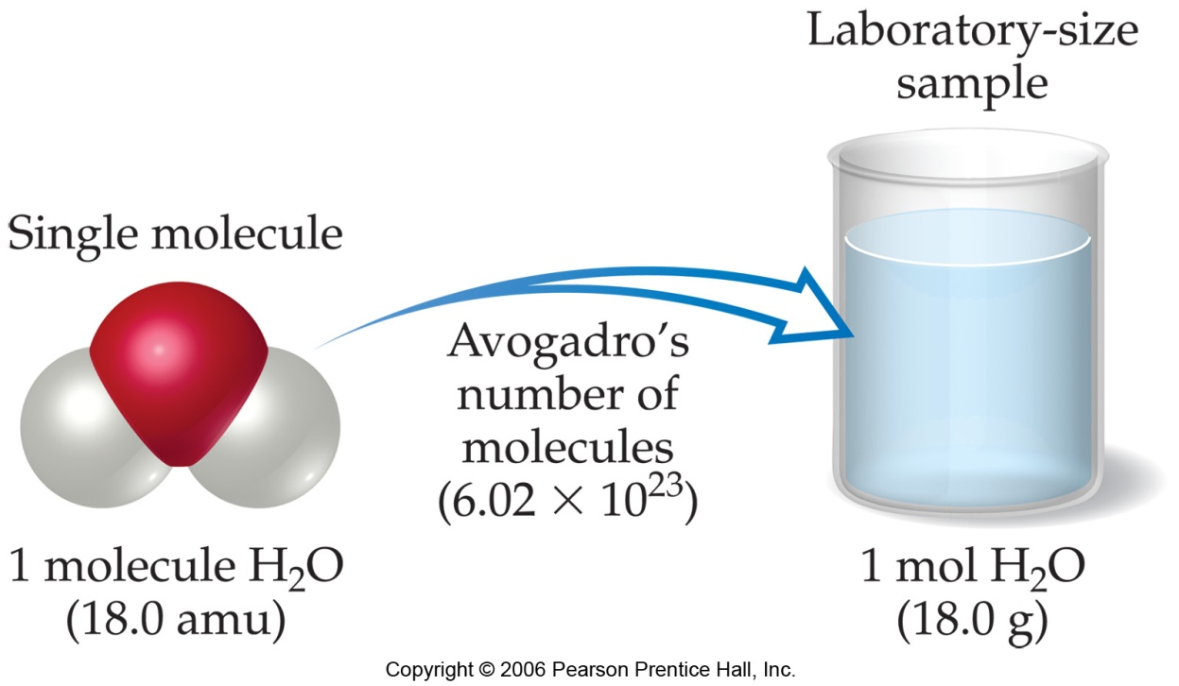
Avogadro's number and the mole
The mole (abbreviated "mol") is a convenient measure of chemical quantities
1 mole of something = 6.022 x 10²³ atoms/molecules of that thing
This number is called Avogadro’s number

Slide 5
Moles of atoms / ions / molecules
Mole concept mainly used for extremely small objects like atoms, molecules and ions. Thus,
1 mole of ¹²C atoms = 6.022 x 10²³ ¹²C atoms
1 mole of H₂O molecules = 6.022 x 10²³ water molecules
1 mole of NO₃¯ ions = 6.022 x 10²³ nitrate ions

Slide 6
Mole concept if used for large objects
A mole of dollars = 6.02 x 10²³ dollars
One mole of marbles, each 2 cm in diameter, would form a mountain 116 times higher than Mount Everest. The base of the marble mountain would be about three times the area of India
Astronomers estimate that there are a mole (6.02 x 10²³) of stars in the universe
Avogadro's number (6.02 x 10²³) is the approximate number of milliliters of water in the Pacific Ocean

Slide 7
For Mole Problems, Call Avogadro: “6022-1023”

Slide 8
Example:
Which has more atoms?
One mole of carbon (C)
One mole of Magnesium (Mg)
Same

Slide 9
Relating mole and individual counts
Consider a sample containing 2.00 mol CO₂. How many molecules are in the sample?
Ans. 1.20 x 10²⁴ molecules of CO₂

Slide 10
Relating mole and individual counts
How many moles of Mg atoms are in a sample containing 3.00 x 10²³ Mg atoms?
Ans. 0.498 moles Mg

Slide 11
Counting atoms in molecules
How many oxygen atoms are in 2 mol CO₂?
Ans. 2.41 x 10²⁴ atoms oxygen

Slide 12
Counting atoms in molecules
How many total atoms are in 2.00 mol CO₂?
How many CO₂ molecules contain 5 mol oxygen atoms?
Ans. 3.61 x 10²⁴ total atoms
Ans. 1.51 x 10²⁴ CO₂ molecules

Slide 13
Counting ions in compounds
How many cations are in 3 mol of ammonium sulphate [ (NH₄)₂SO₄]?
Ans. 3.61 x 10²⁴ cations

Slide 14
Test Yourself
Which has more molecules?
1 mole SO₂
1 mole SO₃
same
Which has more atoms?
1 mole SO₂
1 mole SO₃
1 mole SO₃

Slide 15
How many atoms are in 2.5 mol sample of carbon?
Ans. 1.51 x 10²⁴ atoms
How many moles of O₂ molecules are in a sample containing 3 x 10²² O₂ molecules?
Ans. 0.05 moles

Slide 16
How many atoms of oxygen are in 1.5 moles of CO₂?
Ans. 1.806 x 10²⁴ oxygen atoms

Slide 17
Test Yourself
Which has more atoms?
3 mol of SO₂
2 mol of SO₃
same
Which has more oxygen atoms?
3 mol of SO₂
2 mol of SO₃
same

Slide 18
How many cations are there in 2 mol Na₃PO₄?
Ans. 3.61 x 10²⁴ cations

Slide 19
How many moles of nitrate ions are in a mixture of 2 mol of calcium nitrate and 1.5 mol of aluminium nitrate?

Slide 20
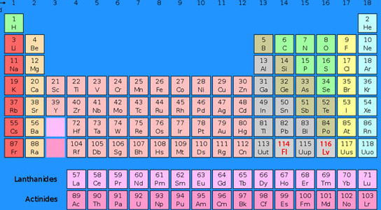
Atomic Weight
The number which indicates how many times an atom of an element is heavier than 1/12th the weight of ¹²C isotope is known as atomic weight. Its unit is amu.

Slide 21
Molecular Weight and Molar Mass
Molecular weight is the number which indicates how many times
a molecule of an element or compound is heavier than 1/12th
the weight of ¹²C isotope. Its unit is amu.
The weight of 1 mole of a compound is known as molar mass.
Its unit is g/mol.
Mass (g/mol) of elements to be considered for molar mass:
H: 1 , C: 12 , N: 14 , O: 16 , Na: 23 , S: 32 , Cl: 35.5
K: 39 , Ca: 40

Slide 22
Steps
Count the total number of each type of atom.
Add the mass of each type of atoms to find the molar mass.
SO₂ = (mass of S) + (2 x mass of oxygen)
= 32 g + (2 x 16) g
= 64 g
Propanol (CH₃CH₂CH₂OH)
= (3 x mass of C) + ( 8 x mass of H) + (1 x mass of oxygen)
= (3 x 12) g + ( 8 x 1) g + (1 x 16) g
= 36 g + 8 g + 16 g
= 60 g
Mass (g/mol) of elements to be considered for molar mass calculation:
H: 1 g, C: 12 g, N: 14 g, O: 16 g, Na: 23 g, Mg: 24 g, P: 31 g, S: 32 g, Cl: 35.5 g, K: 39 g, Ca: 40 g

Slide 23
CuSO₄.5H₂O = (mass of Cu) + (mass of S) + (4 x mass of O)
+ {5 x [(2 x mass of H) + (mass of O)]}
= 63.5 g + 32 g + (4 x 16)g + {5 x [(2 x 1)g + 16 g]}
= 63. 5 g + 32 g + 64 g + (5x18)g
= 159.5 g + 90 g
= 249.5 g
Mass (g/mol) of elements to be considered for molar mass calculation:
H: 1 g, C: 12 g, N: 14 g, O: 16 g, Na: 23 g, Mg: 24 g, P: 31 g, S: 32 g, Cl: 35.5 g, K: 39 g, Ca: 40 g, Cu: 63.5 g

Slide 24
Find the molar mass of:
Ca(NO₃)₂
(NH₄)₃PO₄
MgSO₄.7H₂O
Ans. 164 g/mol
Ans. 149 g/mol
Ans. 246 g/mol
Mass of elements to be considered for molar mass calculation:
H: 1 g, C: 12 g, N: 14 g, O: 16 g, Na: 23 g, Mg: 24 g, P: 31 g, S: 32 g, Cl: 35.5 g, K: 39 g, Ca: 40 g, Cu: 63.5 g

Slide 25
Formula Weight (FW)
A formula weight is the sum of the atomic weights for the atoms in a chemical formula
Example: The formula weight of calcium chloride, CaCl₂, would be
Ca: 1 (40 amu)
+ Cl: 2 (35.5 amu)
111 amu
Formula weights are generally reported for ionic compounds

Slide 26
Molecular Weight (MW)
A molecular weight is the sum of the atomic weights of the atoms in a molecule
Molecular weight is the term used for covalent compounds
For the molecule ethane, C₂H₆, the molecular weight would be
C: 2 (12.0 amu)
+ H: 6 (1.0 amu)
30.0 amu

Slide 27
Molecular Weight (MW)
For the molecule Glucose, C₆H₁₂O₆ , the molecular weight would be
C: 6 (12.0 amu)
+ H: 12 (1.0 amu)
+ O: 6 (16.0 amu)
180.0 amu

Slide 28
The formula weight of aluminum sulfate Al₂(SO₄)₃ is __________ amu
342
123
59
150
273

Slide 29
The formula of nitrobenzene is C₆H₅NO₂. The molecular weight of this compound is __________ amu
107
43
109
123
133

Slide 30
Molar mass
Molar mass is the mass in grams, of one mole of a substance
Since one mole contains 6.02 x 10²³ atoms / molecules, molar mass is the combined mass of all these atoms/molecules
Molar mass is expressed in units of g/mole or g.mole⁻¹

Slide 31
Molar mass of an element/compound
For an element the molar mass is the atomic mass of the element as seen in the periodic table with units expressed in grams
Example: 1 mole of chlorine atoms (i.e. 6.02 x 10²³ Cl atoms) will have a mass of 35.5 g
For a compound the molar mass is the formula weight / molecular weight of that compound with units expressed in grams
Example: 1 mole of water molecules (i.e. 6.02 x 10²³ H₂O molecules) will have a mass of 18 g

Slide 32
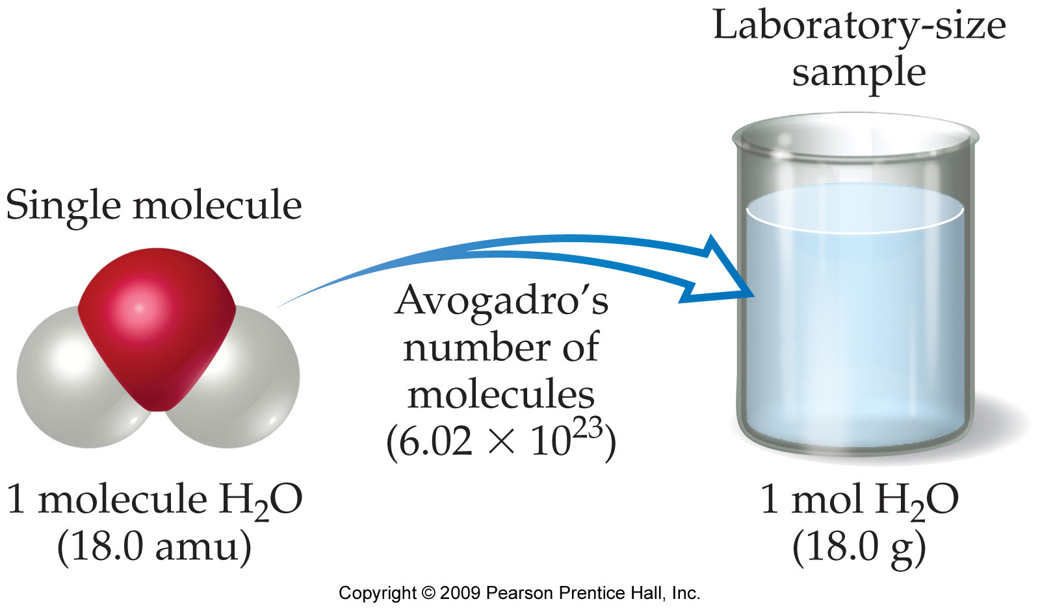
Molar mass of a water

Slide 33
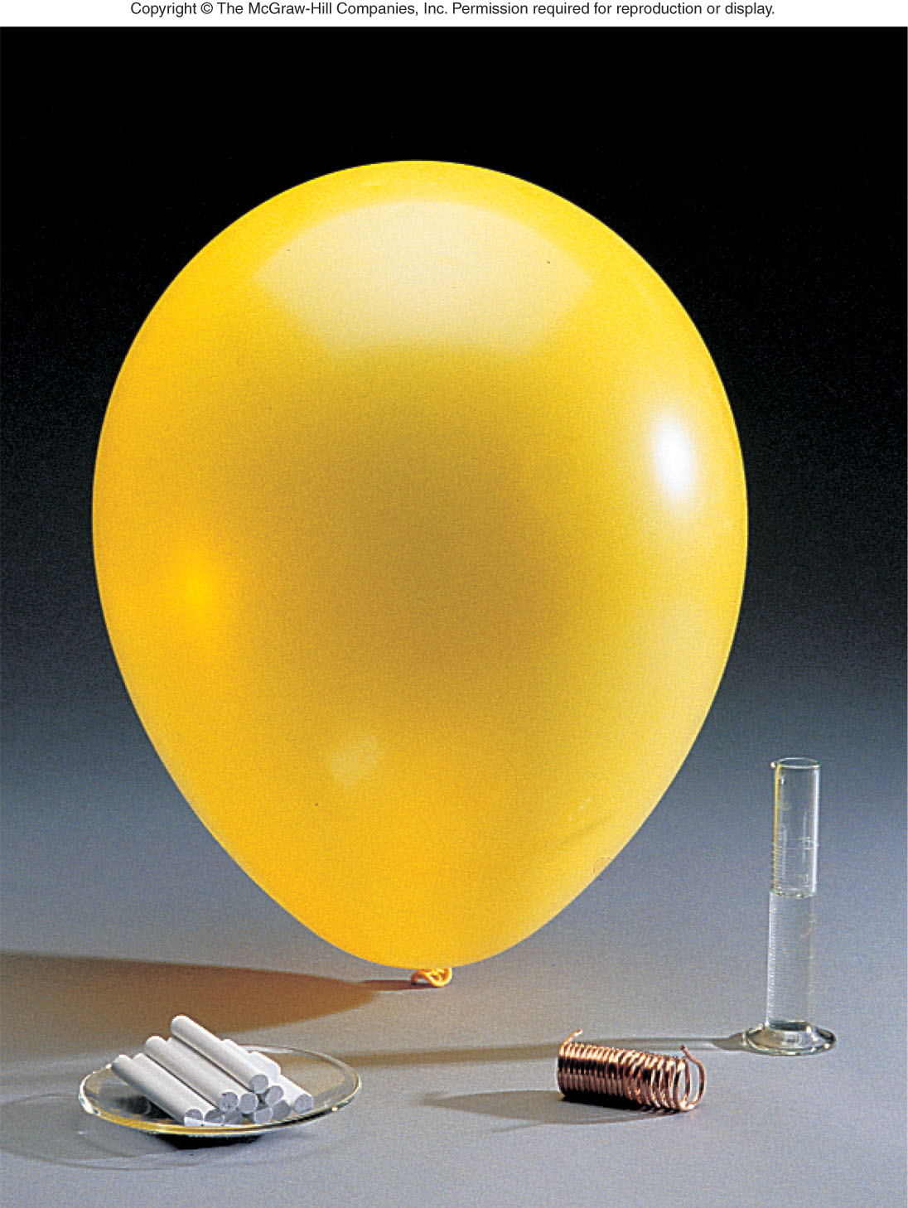
One mole of common substances
Oxygen
32.00 g
In each of these samples, there are 6.02 x 10²³ particles
Water
18.02 g
CaCO₃
100.09 g
Copper
63.55 g

Slide 34
Number of atoms / molecules in polyatomic species
Name of substance | Symbol/ Formula | Atomic mass/ FW/MW (amu) | Molar mass (g/mol) | Number and kind of particles per mole
Atomic nitrogen | N | 14.0 | 14.0 | 6.02 x 10²³ nitrogen atoms
Molecular nitrogen | N₂ | 28.0 | 28.0 | 2(6.02 x 10²³) nitrogen atoms 6.02 x 10²³ nitrogen molecules
Atomic oxygen | O | 16.0 | 16.0 | 6.02 x 10²³ oxygen atoms
Molecular oxygen | O₂ | 32.0 | 32.0 | 2(6.02 x 10²³) oxygen atoms 6.02 x 10²³ oxygen molecules

Slide 35
How many methane molecules are there in 2.52 moles of methane (CH₄) ?
Ans. 1.52 x 10²⁴ molecules of methane

Slide 36
How many oxygen atoms are there in 7.2 g of nitric acid (HNO₃) ?
Ans. 2.06 x 10²³ oxygen atoms

Slide 37
How many total number of atoms are there in 2.00 moles of CO₂ ?
Ans. 3.6 x 10²⁴ total number of atoms

Slide 38
How many moles of glucose are there in 63 g of glucose (C₆H₁₂O₆) ?
Ans. 0.35 moles glucose

Slide 39
Practice How many moles of cations are there in 2.00 moles of sodium phosphate (Na₃PO₄) ?
Ans. 6 moles of cations

Slide 40
Practice How many total number of moles of nitrate ions are there in a mixture of 2.00 moles of calcium nitrate Ca(NO₃)₂ and 1.50 moles of aluminum nitrate Al(NO₃)₃?
Ans. 8.5 moles of nitrate ions

Slide 41
Practice What mass of Fe is present in Fe₃O₄ that contains 4.8 × 10²³ atoms of oxygen?
Ans. 33.48 g of Fe

Slide 42
Practice How many molecules of CO₂ will contain 5 moles of oxygen atoms?
Ans. 1.51 x 10²⁴ molecules of CO₂

Slide 43
Practice How many cations are there in 3 moles of ammonium sulfate, (NH₄)₂SO₄
Ans. 3.61 x 10²⁴ ammonium cations

Slide 44
Practice What would be the weight of 3.3 × 10^{─3} moles of MgSO₄. 7H₂O
Ans. 0.811 g

Slide 45
Practice What would be the weight of a sample of copper sulfate pentahydrate, CuSO₄ . 5H₂O, that contains 3.0 × 10²⁰ atoms.
Ans. 5.92 x 10^{─3} g CuSO₄ . 5H₂O

Slide 46
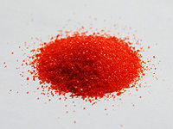
How many grams of potassium are there in 5.4g of K₂Cr₂O₇ ?
Ans. 1.43 g potassium

Slide 47
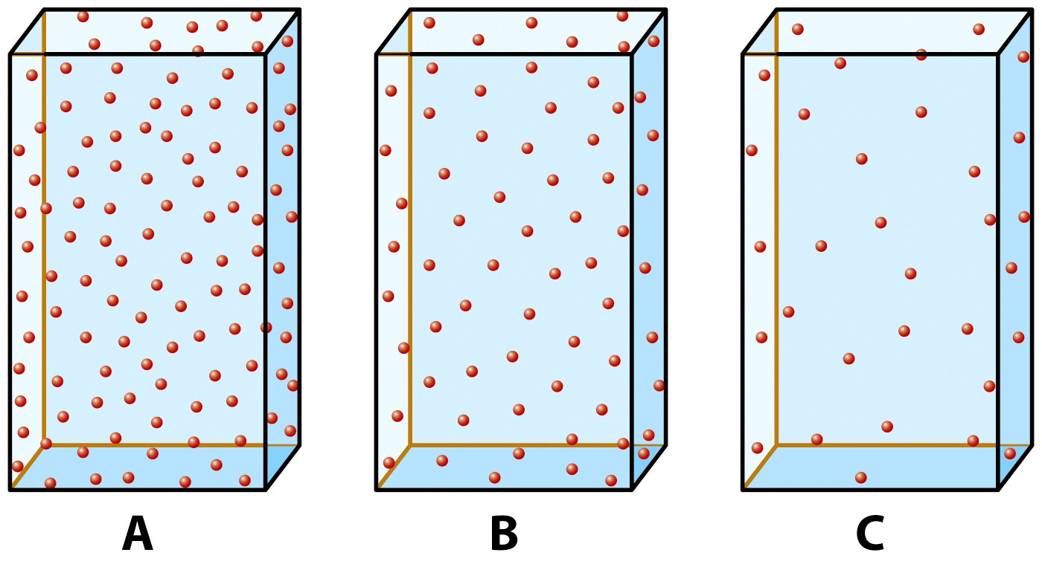
Concentration - the amount of substance
The concentration above decreases as A > B > C

Slide 48
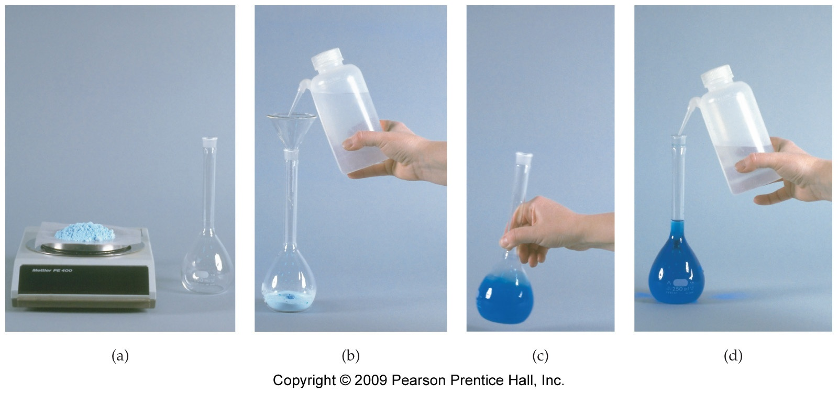
Preparing a solution of known concentration

Slide 49
Expressing concentration in terms of molarity
Molarity is a measure of the concentration and is based on chemical mass units
Molarity is defined as the number of moles of the solute dissolved per liter of solution (not solvent)
The symbol for this type of concentration unit is “M”
Example, a 2.0 M solution of glucose means 2.0 moles of glucose are dissolved in 1.0 L of solution

Slide 50

What mass of KCl (g) will be required to prepare 600 mL of 2.2M aqueous solution of KCl ?
(2.2M KCl solution = 2.2 moles of KCl in 1000 mL i.e. 1L solution)
Ans. 98.3 g KCl

Slide 51
What is the molarity (M) of a MgBr₂ solution in which 72g of MgBr₂ is dissolved in 500 mL of the solution?
(Molarity = no. of moles per liter of the solution)
Ans. 0.78 M

Slide 52
How many moles of KCl are there in 630 mL of 0.81M aqueous solution of KCl ?
Ans. 0.51 moles KCl

Slide 53
What volume (mL) of a 7.2M solution of glucose will contain 0.9 moles of glucose ?
Ans. 125 mL solution

Slide 54
Dilution
Dilution – distribution of a given quantity of a substance over a larger volume
To prepare a very dilute solution, the usual way is to prepare a concentrated solution and then dilute it to the desired concentration
Example, to prepare 10 mL of a 10⁻⁶ M solution of CaCO₃ one will have to dissolve 1µg in 10 mL of the solution. Instead a 0.01M solution can be prepared and 1µL of this solution diluted to 10 mL

Slide 55
Dilution and number of moles
Moles solute (before dilution) = Moles solute (after dilution)
Thus, moles_{concentrated solution} = moles_{dilute solution}
But,
Thus, M_{concentrated} x V_{concentrated} = M_{dilute} x V_{dilute}
OR
M_{I}V_{I} = M_{F}V_{F}
(where I and F represent initial and final)

Slide 56
What is the final volume (L) of a 0.07 M solution of CaCl₂ prepared by dilution of 200 mL of a 1M solution ?
Ans. 2.86L

Slide 57
What is the initial concentration (moles per liter) of a 100 mL solution that has been diluted to give 500 mL of a 0.5 M solution?
Ans. 2.5M

